Slide 1
Visualising data
Dr. Domhnall Carlin

Slide 2
Objectives
Use Python to plot some data
Learn the basics of figures
Save plots for publication

Slide 3
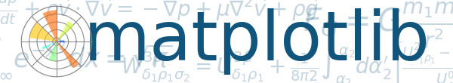
Matplotlib is a library for making 2D plots of arrays in Python.
Origins in emulating the MATLAB graphics commands, it is independent of MATLAB, and can be used in a Pythonic, object oriented way.
Matplotlib is written primarily in pure Python
Makes heavy use of NumPy and other extension code to provide good performance even for large arrays.
D. Hunter, "Matplotlib: A 2D Graphics Environment", Computing in Science & Engineering, vol. 9, no. 3, pp. 90-95, 2007.

Slide 4
Matplotlib is designed with the philosophy that you should be able to create simple plots with just a few commands, or just one!
If you want to see a histogram of your data, you shouldn't need to instantiate objects, call methods, set properties, and so on; it should just work.
Notes:
Easy to get started, can be complicated

Slide 5
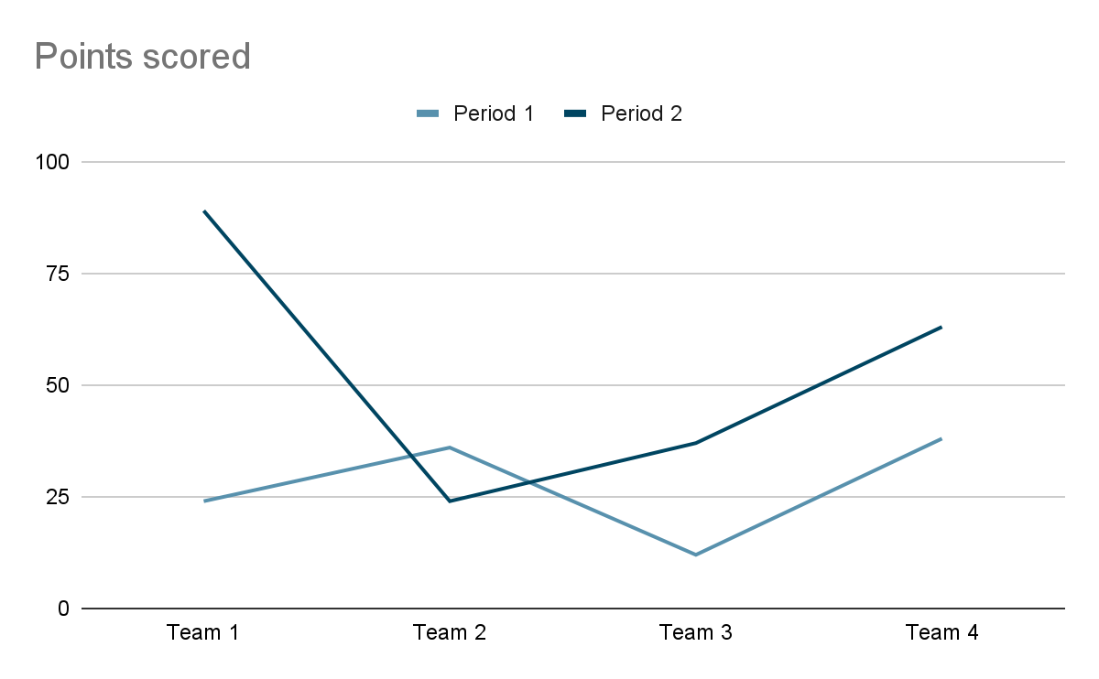
Plot is hierarchical
Figure object which contains 1+:
Axes object (the graph)
Artists (Ticks, lines, legends, text etc.)
Figure
Axes
Artists
Notes:
Easy to get started, can be complicated

Slide 6
Figure
Axes
Notes:
Easy to get started, can be complicated

Slide 7
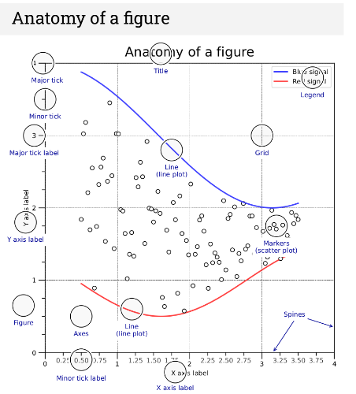
KEY POINTS
The Figure is the final image that may contain 1 or more Axes.
The Axes represent an individual plot (don't confuse this with the word "axis", which refers to the x/y axis of a plot).
https://matplotlib.org/cheatsheets/_images/handout-beginner.png

Slide 8
Using Matplotlib
There are two ways to use Matplotlib:
Object-oriented (OO): Explicitly create Figures and Axes, and call methods on them.
Pyplot: to automatically create and manage the Figures and Axes, and use pyplot functions for plotting.
Notes:
If you want to see a histogram of your data, you shouldn't need to instantiate objects, call methods, set properties, and so on; it should just work.

Slide 9
Using Matplotlib.pyplot
matplotlib.pyplot is a collection of functions that make matplotlib work like MATLAB.
Each pyplot function makes some change to a figure: e.g., creates a figure, creates a plotting area in a figure, plots some lines in a plotting area, decorates the plot with labels, etc.
In matplotlib.pyplot various states are preserved across function calls, so that it keeps track of things like the current figure and plotting area, and the plotting functions are directed to the current axes.
REMEMBER that "axes" here and in most places in the documentation refers to the axes part of a figure and not the strict mathematical term for more than one axis).
the pyplot API is generally less-flexible than the object-oriented API.
Notes:
Most of the function calls you see here can also be called as methods from an Axes object.

Slide 10
x = np.linspace(0, 2, 100) # Sample data.
# Note that even in the OO-style, we use `.pyplot.figure` to create the Figure.
fig, ax = plt.subplots(figsize=(5, 2.7), layout='constrained')
ax.plot(x, x, label='linear') # Plot some data on the axes.
ax.plot(x, x**2, label='quadratic') # Plot more data on the axes...
ax.plot(x, x**3, label='cubic') # ... and some more.
ax.set_xlabel('x label') # Add an x-label to the axes.
ax.set_ylabel('y label') # Add a y-label to the axes.
ax.set_title("Simple Plot") # Add a title to the axes.
ax.legend(); # Add a legend.
Notes:
OO style Note we still call fig

Slide 11
x = np.linspace(0, 2, 100) # Sample data.
plt.figure(figsize=(5, 2.7), layout='constrained')
plt.plot(x, x, label='linear') # Plot some data on the (implicit) axes.
plt.plot(x, x**2, label='quadratic') # etc.
plt.plot(x, x**3, label='cubic')
plt.xlabel('x label')
plt.ylabel('y label')
plt.title("Simple Plot")
plt.legend();
Notes:
And the pyplot style

